Slide 1
Department of Computer Science & Business Systems
SUBJECT: Usability Design of Software Applications
Subject Code:
Topic Name: Personas and Scenarios
IV year, Sec: A
Vallurupalli Nageswara Rao Vignana Jyothi Institute of Engineering &Technology
Bhagya Rekha Konkepudi
Assistant Professor
Email: bhagyarekha_k@vnrvjiet.in
<Web link of your created resource if any>

Slide 2
Agenda
Personas and Scenarios:
  Scenarios and Persona Technique
  Overview of Design Thinking Technique
  Discovery and brainstorming

Slide 3
personas
Creating Personas
Collecting all sorts of data about your users can be incredibly valuable, but sometimes you can lose sight of the real people behind all the statistics. You can make your users more real by turning them into personas (sometimes called user models or user profiles).
A persona is a fictional character constructed to represent the needs of a whole range of real users. By putting a face and a name on the disconnected bits of data from your user research and segmentation work, personas can help ensure that you keep the users in mind during the design process.
Personas are fictional characters drawn from user research who serve as example cases during user experience development.

Slide 4
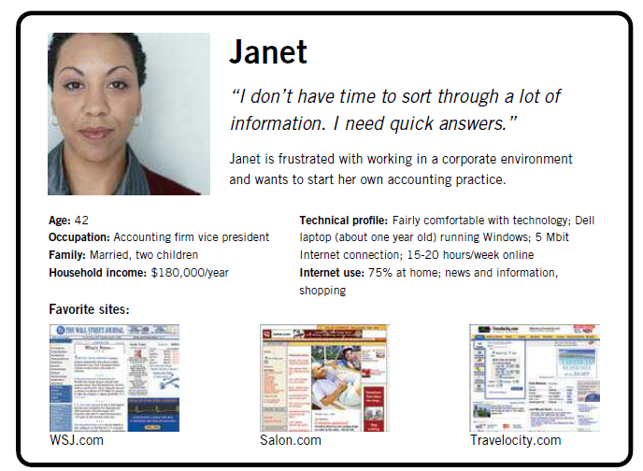
personas
Creating Personas - Example
Let’s look at an example. Suppose our site is designed to provide information for people who are starting their own businesses. We know from our research that our audience mostly falls in the 30–45 age range. Our users tend to be fairly comfortable with the Web and technology in general. Some of them have a lot of experience in the business world; for others, this is their first exposure to all of the issues involved in running a business.
In this case, it might be appropriate to create two personas. We’ll call the first one Janet. She’s 42 years old, she’s married, and she has two kids. She’s spent the last couple of years as a vice president at a large accounting firm. She’s become frustrated with working for other people, and now she wants to build a company of her own.

Slide 5
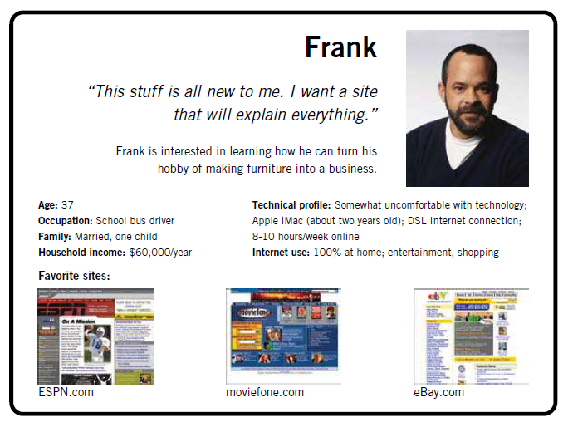
personas
Creating Personas - Example
The second persona is Frank. He’s 37 years old and married with one child. Woodworking has been a weekend hobby of Frank’s for many years. Some friends of his were impressed by some furniture he made, so he’s been thinking he could go into business for himself by selling his work. He’s not sure if he’ll have to quit his job as a school bus driver in order to launch his new business.

Slide 6
personas
Creating Personas – Example
Where did all this information come from? Well, for the most part, we made it up. We want our personas to be consistent with what we know about the users from our research, but the specific details of our personas are fictional inventions, used to breathe life into these characters who will stand in for our real, live users.
Janet and Frank represent the range of user needs we’ll have to keep in mind as we’re making decisions about the user experience of our site.
To help us remember them and their needs, we’ll grab a couple of stock photos to give Janet and Frank a little more identity, and combine those photos with the information about them we’ve put together.
These profiles can be printed out and posted around the office so that when we have decisions to make we can ask ourselves (and each other):
  “Would that work for Janet?
  How would Frank react to it?”
The personas help us keep our users in mind every step of the way.

Slide 7
Scenarios
we looked at the technique of creating fictional characters called personas to help us better understand user needs. In determining requirements, we can use those personas again by putting our fictional characters into little stories called scenarios.
A scenario is a short, simple narrative describing how a persona might go about trying to fulfill one of those user needs. By imagining the process our users might go through, we can come up with potential requirements to help meet their needs.
Scenarios are informal stories about user tasks and activities. Scenarios can be used to model existing work situations, but they are more commonly used for expressing proposed or imagined situations to help in conceptual design. Often, stakeholders are actively involved in producing and checking through scenarios for a product. Bødker suggests four roles (Bødker, 2000, p. 63):
  As a basis for the overall design.
  For technical implementation.
  As a means of cooperation within design teams.
  As a means of cooperation across professional boundaries, i.e. as a basis of communication in a multidisciplinary team.

Slide 8
Scenarios
In any one project, scenarios may be used for any or all of these. More specifically, scenarios have been used as scripts for user evaluation of prototypes, as the basis of storyboard creation (see Section 11.6.1), and to build a shared understanding among team members.
Scenarios are good at selling ideas to users, managers, and potential customers. Bødker proposes the notion of plus and minus scenarios. These attempt to capture the most positive and the most negative consequences of a particular proposed design solution (see Figure 11.12), thereby helping designers to gain a more comprehensive view of the proposal. This idea has been extended by Mancini et al (2010) who use positive and negative video scenarios to explore futuristic technology.

Slide 9
Scenarios
Scenario 3: Hyper-wonderland
This scenario addresses the positive aspects of how a hypermedia solution will work. The setting is the Lindholm construction site sometime in the future.
Kurt has access to a portable PC. The portables are hooked up to the computer at the site office via a wireless modem connection, through which the supervisors run the hypermedia application.
Action: During an inspection of one of the caissons1 Kurt takes his portable PC, switches it on and places the cursor on the required information. He clicks
the mouse button and gets the master file index together with an overview of links. He chooses the links of relevance for the caisson he is inspecting.
Kurt is pleased that he no longer needs to plan his inspections in advance. This is a great help because due to the ‘event-driven’ nature of the inspection, constructors never know where and when an inspection is taking place. Moreover, it has become much easier to keep track of personal notes, reports, etc. because they can be entered directly on the spot.
The access via the construction site interface does not force him to deal with complicated keywords either. Instead, he can access the relevant information right away, literally from where he is standing.
A positive side-effect concerns his reachability. As long as he has logged in on the computer, he is within reach of the secretaries and can be contacted when guests arrive or when he is needed somewhere else on the site. Moreover, he can see at a glance where his colleagues are working and get in touch with them when he needs their help or advice.
All in all, Kurt feels that the new computer application has put him more in control of things.
Used in building to hold water back during construction.

Slide 10
Scenarios
Scenario 4: Panopticon
This scenario addresses the negative aspects of how a hypermedia solution will work. The setting is the Lindholm construction site sometime in the future.
Kurt has access to a portable PC. The portables are hooked up to the computer at the site office via a wireless modem connection, through which the supervisors run the hypermedia application.
Action: During inspecting one of the caissons Kurt starts talking to one of the builders about some reinforcement problem. They argue about the recent lab tests, and he takes out his portable PC in order to provide some data which justifies his arguments. It takes quite a while before he finds a spot where he can place the PC: either there is too much light, or there is no level surface at a suitable height. Finally, he puts the laptop on a big box and switches it on. He positions the cursor on the caisson he is currently inspecting and clicks the mouse to get into the master file. The table of contents pops up and from the overview of links he chooses those of relevance – but no lab test appears on the screen. Obviously, the file has not been updated as planned.
Kurt is rather upset. This loss of prestige in front of a contractor engineer would not have happened if he had planned his inspection as he had in the old days.
Sometimes. he feels like a hunted fox, especially in situations where he is drifting around thinking about what kind of action to take in a particular case. If he has forgotten to log out, he suddenly has a secretary on the phone: “I see you are right at caisson 39, so could you not just drop by and take a message?”
All in all Kurt feels that the new computer application has put him under control.

Slide 11
Design Thinking
Design Thinking is a mindset for exploring complex problems or finding opportunities in a world full of uncertainty. It’s a search for meaning, usually focusing on human needs and experience. Using intuitive and abductive reasoning, Design Thinking explores and questions what is, and then imagines what could be with innovative and inventive future solutions.
Elements of Design Thinking
Design Thinking is about designed as a verb. It’s about the act of designing. Donald Norman, author of The Design of Everyday Things and the Godfather of user experience,1 describes it nicely:
Designers don’t search for a solution until they have determined the real problem, and even then, instead of solving that problem, they stop to consider a wide range of potential solutions. Only then will they converge upon their proposal. This process is called Design Thinking.
Let’s look at the component parts in Norman’s definition:
  Determining the real problem
  Searching for solutions
  Considering many options
  Converging on a proposal

Slide 12
Design Thinking Is for All
Design Thinking is not something special, that only designers do. Everyone designs, whether it’s conscious or not. Design is not just the result of a designer’s work. It’s an activity that is inclusive and collaborative. With a little thought, anyone can use the design mindset. This is increasingly true in domains not considered the heartland of design, like corporations, government, health, not-for-profit organizations, and education.
AirBnB was a failing startup in 2009. Challenging its beliefs about how to win, putting itself in its customer’s shoes, and exploring solutions that don’t scale is how AirBnB learned its way to outrageous success. Design Thinking firm IDEO partnered with Kraft, first to spark a change in how the company collaborates internally to innovate its supply-chain process design. Then, with some of Kraft’s biggest customers, like Safeway, to transform operations for mutual benefit. And, finally scaling Design Thinking as a core capability at Kraft, enabling “joint value creation” with many more of their customers globally. Then, there’s the Mayo Clinic Center for Innovation, where Design Thinking is at the heart of transforming the healthcare patient experience.
The popularization of Design Thinking over the past decade is changing what it means to be a designer. And it means more than ever that everyone participates in design.

Slide 13
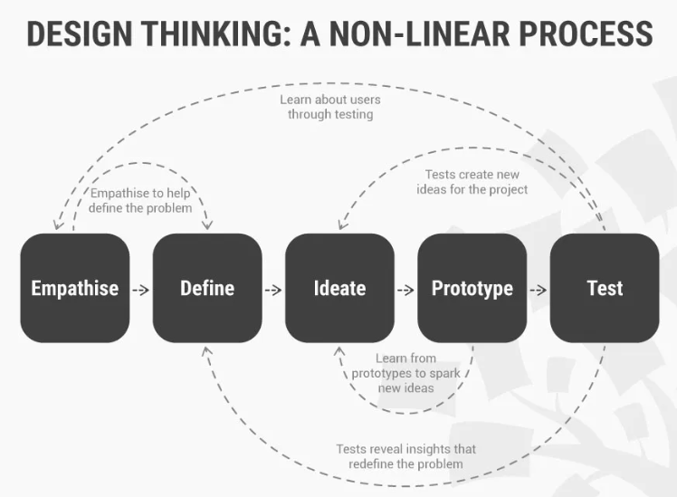
Design Thinking : A NON-LINEAR PROCESS

Slide 14
Design Thinking : A NON-LINEAR PROCESS
Design thinking is a methodology that provides a solution-based approach to solving problems. It’s extremely useful when used to tackle complex problems that are ill-defined or unknown—because it serves to understand the human needs involved, reframe the problem in human-centric ways, create numerous ideas in brainstorming sessions and adopt a hands-on approach to prototyping and testing.
Learning about the five stages of design thinking will empower you and allow you to apply the methodology to your work and solve complex problems that occur in our companies, our countries, and across the world.
Design thinking is a non-linear, iterative process that can have anywhere from three to seven phases, depending on whom you talk to. We focus on the five-stage design thinking model proposed by the Hasso Plattner Institute of Design at Stanford (the d.school) because they are world-renowned for the way they teach and apply design thinking.
The five stages of design thinking, according to the d.school, are:
  Empathize and research your users' needs.
  Define: state your users' needs and problems.
  Ideate: challenge assumptions and create ideas.
  Prototype: start to create solutions.
  Test: try your solutions out.

Slide 15
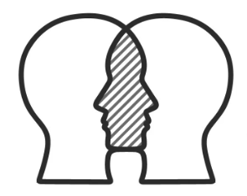
Stage 1: Empathize—Research Your Users' Needs
The first stage of the design thinking process focuses on user-centric research. You want to gain an empathic understanding of the problem you are trying to solve. Consult experts to find out more about the area of concern and conduct observations to engage and empathize with your users. You may also want to immerse yourself in your users’ physical environment to gain a deeper, personal understanding of the issues involved—as well as their experiences and motivations. Empathy is crucial to problem-solving and a human-centered design process as it allows design thinkers to set aside their own assumptions about the world and gain real insight into users and their needs.
Depending on time constraints, you will gather a substantial amount of information to use during the next stage. The main aim of the Empathize stage is to develop the best possible understanding of your users, their needs, and the problems that underlie the development of the product or service you want to create.

Slide 16
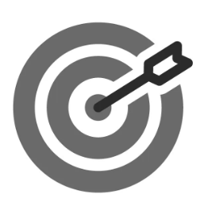
Stage 2: Define—State Your Users' Needs and Problems
In the Define stage, you will organize the information you have gathered during the Empathize stage. You’ll analyze your observations to define the core problems you and your team have identified up to this point. Defining the problem and problem statement must be done in a human-centered manner.
For example, you should not define the problem as your own wish or need of the company: “We need to increase our food-product market share among young teenage girls by 5%.”
You should pitch the problem statement from your perception of the users’ needs: “Teenage girls need to eat nutritious food in order to thrive, be healthy, and grow.”
The Define stage will help the design team collect great ideas to establish features, functions, and other elements to solve the problem at hand—or, at the very least, allow real users to resolve issues themselves with minimal difficulty. In this stage, you will start to progress to the third stage, the ideation phase, where you ask questions to help you look for solutions: “How might we encourage teenage girls to perform an action that benefits them and also involves your company’s food-related product or service?” for instance.

Slide 17
Stage 3: Ideate—Challenge Assumptions and Create Ideas
During the third stage of the design thinking process, designers are ready to generate ideas. You’ve grown to understand your users and their needs in the Empathize stage, and you’ve analyzed your observations in the Define stage to create a user centric problem statement. With this solid background, you and your team members can start to look at the problem from different perspectives and ideate innovative solutions to your problem statement.
There are hundreds of ideation techniques you can use—such as Brainstorm, Brainwriting, Worst Possible Idea and SCAMPER. Brainstorm and Worst Possible Idea techniques are typically used at the start of the ideation stage to stimulate free thinking and expand the problem space. This allows you to generate as many ideas as possible at the start of ideation. You should pick other ideation techniques towards the end of this stage to help you investigate and test your ideas, and choose the best ones to move forward with—either because they seem to solve the problem or provide the elements required to circumvent it.

Slide 18
Stage 4: Prototype—Start to Create Solutions
The design team will now produce a number of inexpensive, scaled down versions of the product (or specific features found within the product) to investigate the key solutions generated in the ideation phase. These prototypes can be shared and tested within the team itself, in other departments or on a small group of people outside the design team.
This is an experimental phase, and the aim is to identify the best possible solution for each of the problems identified during the first three stages. The solutions are implemented within the prototypes and, one by one, they are investigated and then accepted, improved or rejected based on the users’ experiences.
By the end of the Prototype stage, the design team will have a better idea of the product’s limitations and the problems it faces. They’ll also have a clearer view of how real users would behave, think and feel when they interact with the end product

Slide 19
Stage 5: Test—Try Your Solutions Out
Designers or evaluators rigorously test the complete product using the best solutions identified in the Prototype stage.
This is the final stage of the five-stage model; however, in an iterative process such as design thinking, the results generated are often used to redefine one or more further problems.
This increased level of understanding may help you investigate the conditions of use and how people think, behave and feel towards the product, and even lead you to loop back to a previous stage in the design thinking process. You can then proceed with further iterations and make alterations and refinements to rule out alternative solutions.
The ultimate goal is to get as deep an understanding of the product and its users as possible.

Slide 20
Design Thinking
Lean UX
Lean UX takes a different approach to user research by focusing on getting products into the market and capturing user feedback on products that are in the marketplace. It specifically focuses on designing and developing innovative products.
Lean UX is designed to create and deploy innovative products quickly. It is linked to AgileUX because agile software development is one of its underlying philosophies, and it champions the importance of providing a good user experience. Lean UX builds upon agile software development, design thinking, and Lean Startup ideas.
All three perspectives emphasize iterative development, a collaboration between all stakeholders, and cross-functional teams. Design thinking focuses on understanding what people want and what technology can deliver. It is derived from professional design practice and takes a holistic view of the context and product while evolving a solution through prototyping, evaluation, and learning.

Slide 21
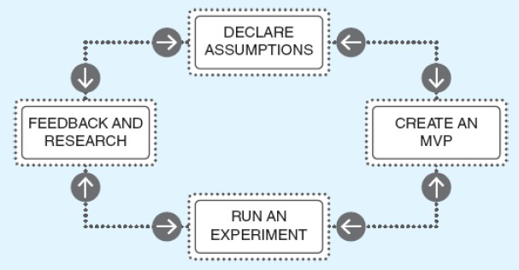
Design Thinking
Lean UX
Lean UX is based on tight iterations of build-measure-learn, a concept central to the Lean Startup idea, which in turn was inspired by the lean manufacturing process from Japan. The Lean UX process is illustrated in Figure

Slide 22
Design Thinking
Lean UX
It emphasizes waste reduction, the importance of experimentation to learn, and the need to articulate assumptions about a planned product.
Assumptions can be expressed as hypotheses and put to the test through research or by building a minimal viable product (MVP) that can be released to the user group.
Testing assumptions is done through experimentation, but before undertaking experimentation, the evidence required to confirm or refute each assumption needs to be characterized.
An MVP is the smallest product that can be built that allows assumptions to be tested by giving it to a user group and seeing what happens.
Experimentation and the evidence collected are therefore based on actual use of the product.

Slide 23
Design Thinking
Lean UX – Example
an example of a company that wanted to launch a monthly newsletter. Their assumption was that a monthly newsletter would be attractive to their customers.
To test this assumption, they put a sign-up form on their website and collected evidence in the form of the number of sign-ups received. This form was an MVP that allowed them to collect evidence to support or refute their assumption, i.e. that a monthly newsletter would be attractive to their customers.

Slide 24
Agile UX
AgileUX is the collective label given to efforts that aim to resolve these concerns by integrating techniques and processes from interaction design and those from agile methods. While agile software development and UX design have some characteristics in common, such as iteration, a focus on measurable completion criteria, and user involvement, AgileUX requires a change in mindset compared to UX design.
In particular, AgileUX requires attention to three practical areas:
  (i) what user research to conduct, how much, and when;
  (ii) how to align UX design and agile working practices; and
  (iii) what documentation to produce, how much, and when.

Slide 25
User Research
The term ‘user research’ refers to the data collection and analysis activities necessary to characterize the users, their tasks, and the context of use before product development begins. Field studies and ethnography are often used in these investigations, and are regarded as the most important element of user-centered design
user research to be conducted before the project begins, or indeed before it is announced (Norman, 2006), hence avoiding the constraints caused by limited timeboxes. This period is often called iteration zero, and it is used to achieve a range of upfront activities including technical architecture design as well as user research.
Another approach to conducting user research for each project is to have an ongoing program of user research that revises and refines a company’s knowledge of its users over a longer time span.
For example, Microsoft actively recruits users of their software to sign up and take part in user research that is used to inform future developments. In this case, the specific data gathering and analysis needed for one project would be conducted during iteration zero, but done in the context of a wider understanding of users and their goals.

Slide 26
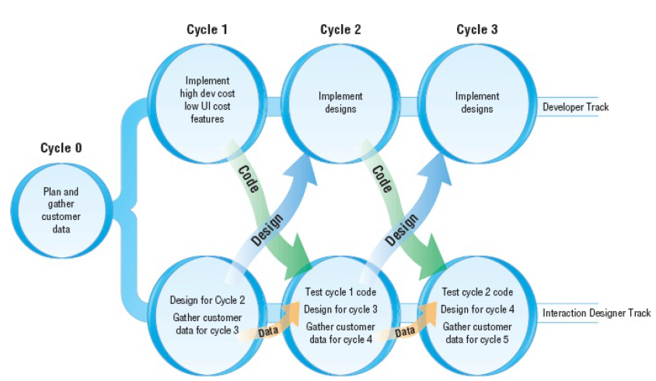
Aligning Work Practices
If requirements are specified before implementation begins, there is a tendency for designers to develop complete UX designs at the beginning of a project in order to ensure a coherent design throughout.
Miller (2006) and Sy (2007) proposed that UX design work is done one iteration ahead of development work, in parallel tracks (see Figure).
The parallel tracks approach to integrating UX design and agile processes originated at Alias – now part of Autodesk. Note that in this diagram, iteration is referred to as Cycle. The principle of parallel tracks development is quite simple: that design activity and user data collection for Cycle n+1 is performed during Cycle n. This enables the design work to be completed just ahead of development work, yet be tightly coupled to it as the product evolves.

Slide 27
Aligning Work Practices
Cycle 0 and Cycle 1 are different from subsequent cycles. Before evolutionary development can begin, the product vision needs to be created.
This is handled in different ways in different agile methods, but all agree that there needs to be some kind of work done upfront to understand the product, its scope, and its overall design (both technical and UX). As discussed above, some user research may have been conducted before Cycle 0, but the vision and overall design is completed for the current project by the end of Cycle 0. The work required will depend on the nature of the product: whether it is a new version of an existing product, a new product, or a completely new experience.

Slide 28
Aligning Work Practices
Example
One of the originators of the parallel tracks development idea, Desiree Sy (2007), explained this in the context of two different products. The first product is SketchBook Pro v2.0 –sophisticated sketching, annotating, and presentation tool to support digital artists – and the second is Autodesk’s Showcase – a real-time automotive 3D visualization product.
For SketchBook Pro v2.0, the team conducted a survey of users who had downloaded v1.0 (a free trial version) but had not purchased v2.0. The results of the survey helped the team to refine 100 features into five major work streams, and this information informed development and prioritization throughout the development.
For Showcase, during Cycle 0 the team interviewed potential purchasers who performed work that the tool was going to be designed to support. This data formed the foundation for the design principles of the product as well as prioritization and design decisions as development progressed.
Cycle 1 usually involves technical setting-up activities in the developer track, which allows the UX designers to get started on the design and user activities for Cycle 2. For subsequent cycles, the team gets into a rhythm of design and user activities in Cycle n-1 and corresponding technical activity in Cycle n.

Slide 29
Documentation
The most common way for UX designers to capture and communicate their design has been through documentation, e.g. user research results and resulting personas, detailed interface sketches, and wireframes. Because UX designers' deliverable is the design, a key indicator that their work can be designed off is if there is sufficient documentation to show that their goals have been achieved.
Other forms of design capture, such as prototypes and simulations, are valuable, but documentation is still the most common. Agile development encourages only minimal documentation so that more time can be spent on design, thus producing value to the user via a working product.
Minimal documentation does not mean ‘no documentation’ and some documentation is desirable in most projects. However, a key principle in AgileUX is that documentation should not replace communication and collaboration. To help identify the right level of documentation, Ratcliffe and McNeill (2012, p. 29) suggest asking a set of questions of any documentation process:

Slide 30
Documentation
To help identify the right level of documentation, Ratcliffe and McNeill (2012, p. 29) suggest asking a set of questions of any documentation process:
How much time do you spend on documentation? Try to decrease the amount of time spent on documentation and increase design time.
Who uses the documentation?
What is the minimum that customers need from the documentation?
How efficient is your sign-off process? How much time is spent waiting for documentation to be approved? What impact does this have on the project?
What evidence is there of document duplication? Are different parts of the business documenting the same things?
If documentation is only for the purpose of communication or development, how polished does it need to be?

Slide 31
Brainstorming for Innovation
Ideation Will Help You:
Ask the right questions and innovate.
Step beyond the obvious solutions and therefore increase the innovation potential of your solution.
Bring together perspectives and strengths of team members.
Uncover unexpected areas of innovation.
Create volume and variety in your innovation options.
Get obvious solutions out of your heads, and drive your team beyond them.

Slide 32
Brainstorming for Innovation
Ideation Methods to Spark Innovative Ideas
There are hundreds of ideation methods. Some methods are merely renamed or slightly adapted versions of more foundational techniques. Here you’ll get a brief overview of some of the best methods:
Brainstorm
Braindump
Brainwrite
Brainwalk
Challenge Assumptions
SCAMPER
Mindmap
Sketch or Sketchstorm
Storyboard
Provocation
Movement
Bodystorm
Gamestorming
Cheatstorm
Crowdstorm
Co-Creation Workshops
Prototype
Creative Pause

Slide 33
Brainstorming for Innovation
Active Facilitation
Although many of us may have previously participated in a Brainstorm session, it is not always easy to facilitate a truly fruitful ideation session, which may be the reason why many of us have had negative experiences in the past. However, Ideation sessions can indeed be fun and exciting, but they demand a lot of preparation and team member concentration in order to be fruitful. To sit the team down with a blank piece of paper and ask them to come up with ideas will likely result in failure. Likewise, to have everyone shout out their own ideas is likely to result in failure.
People need guidance, inspiration, and activities, in a physical and cognitive manner, in order to get the process started. Ideation is a creative and concentrated process; those involved should be provided with an environment that facilitates free, open, and non-judgemental sharing of ideas.
If the process begins to slow down and people seem to be running into a dead-end, the facilitator should impose constraints, such as: "what if there was no top-level navigation bar?" or "How-might-we go about the task if we were 8 years old?" Alternatively, you might want to set targets, such as filling a brainstorming sheet within ten minutes. To start understanding what it takes to facilitate a successful Ideation session, we’ll take a closer look at the best Brainstorming rules.

Slide 34
Brainstorming for Innovation
Brainstorming is not a technique specific to interaction design, or to any other discipline, and is a generic technique used to generate, refine, and develop ideas. It is widely used in interaction design specifically for generating alternative designs or for suggesting new and better ideas for supporting users.
Various rules have been suggested for making a brainstorming session successful, some of which we list below. For requirements, two key success factors are firstly that the participants should know the users’ goals that the product is to support, and secondly that no ideas should be criticized or debated (Robertson and Robertson, 2013; Kelley, 2008). Some other suggestions for successful requirements brainstorms are:
  Include participants from a wide range of disciplines, with a broad range of experience (Robertson and Robertson, 2013; Kelley, 2008).
  Don't ban silly stuff (Kelley, 2008). Wild ideas often turn into really useful requirements (Robertson and Robertson, 2013).
  Use catalysts for further inspiration. Build one idea on top of another (Robertson and Robertson, 2013). Kelley (2008) also suggests jumping back to an earlier idea, or considering alternative interpretations when energy levels start to flag. If you get stuck, use a word pulled randomly from a dictionary to prompt ideas related to the product (Robertson and Robertson, 2013).

Slide 35
Brainstorming for Innovation
4. Keep records. Robertson and Robertson (2013) suggest that every idea should be captured, without censoring. Kelley (2008) suggests that you number them so that you can refer back to ideas more easily. He also suggests that the walls and tables in the room be covered in paper and that participants be encouraged to sketch, mind-map, and diagram ideas, including keeping the flow of ideas, as spatial memory is very strong and this can facilitate recall.
5. Sharpen the focus (Kelley, 2008). Start the brainstorming with a well-honed problem. This will get the brainstorming off to a good start and makes it easier to pull people back to the main topic if the session wanders.
6. Use warm-up exercises and make the session fun (Robertson and Robertson, 2013). The group will require warming up if they haven’t worked together before, most of the group don't brainstorm regularly, or the group is distracted by other pressures (Kelley, 2008). Warm-up exercises might take the form of word games, or the exploration of physical items related or unrelated to the problem at hand.

Slide 36
Brainstorming for Innovation
We’ve summarised the best practices and brainstorming rules from the Institute of Design at Stanford (d.school) and the successful design company, IDEO which celebrates Design Thinking.
  Set a time limit
  Start with a problem statement, point of view, possible questions, a plan, or a goal, and stay focused on the topic: Identify the core subject or the main aim of the exercise. For example, what are you trying to achieve? Are you trying to improve a certain feature? Are you focusing on ways to improve the overall experience? Condense the main issue into a problem statement and condense it into a short “How Might We” sentence. You may even be able to synthesize this into a single word. Your ideas should always branch off from this central headline.

Slide 37
Brainstorming for Innovation
3. Stay on Topic: It is easy to veer off and take lots of different directions during brainstorming sessions, especially when you are trying to be open-minded and unconstrained in your efforts to come up with ideas. It is important that members stay on topic. Focus is essential; otherwise, the process can become confusing, or ideas can become muddled and cross between solutions for other problems. Every effort should be made by the facilitator to keep members on the central theme and goal. You might even want to designate a particular brainstormer to maintain the thread and prevent team members from veering off course.
4. Defer judgment or criticism, including non-verbal: The brainstorming environment is not the time to argue or for questioning other members’ ideas; each member has a responsibility to foster relations that advance the session. For this reason, judgment comes later so rather than blocking an idea, you and your other team members are encouraged to come up with your own ideas that sprout off from those provided by the other members of your team.

Slide 38
Brainstorming for Innovation
5. Encourage weird, wacky and wild ideas: Once again, as brainstorming is a creative activity, each member should try to encourage other members and create an environment in which they feel comfortable verbalising their ideas. Free thinking may produce some ideas that are wide off the mark, but brainstorming is about drawing up as many ideas as possible which are then whittled down until the best possible option remains.
6. Aim for quantity: Brainstorming is effectively a creative exercise, in which design thinkers are encouraged to let their imaginations run wild. The emphasis is on quantity, rather than quality at this stage.
7. Build on each others' ideas: One idea typically leads on from another; by considering the thoughts, opinions, and ideas of other team members during the brainstorming session, new insights and perspectives can be achieved, which then inform one's own ideas. Thus, the team will continue to build ideas which hopefully become progressively more refined and targeted towards the central issue.

Slide 39
Brainstorming for Innovation
8. Be visual: The physical act of writing something down or drawing an image in order to bring an idea to life can help people think up new ideas or view the same ideas in a different way. The brainstorming session is more likely to evolve if team members visualize and bring ideas to life rather than rely on discussion alone.
9. One conversation at a time: Design thinkers (or brainstormers) should focus on one point or conversation at a time so as not to muddy their thinking and lose sight of the thread or current objective.

Slide 40
Brainstorming for Innovation

Slide 41
WIT and WIL Scenario

Slide 42
Practice Questions

Slide 43
References

Slide 44
THANK YOU

